Slide 1
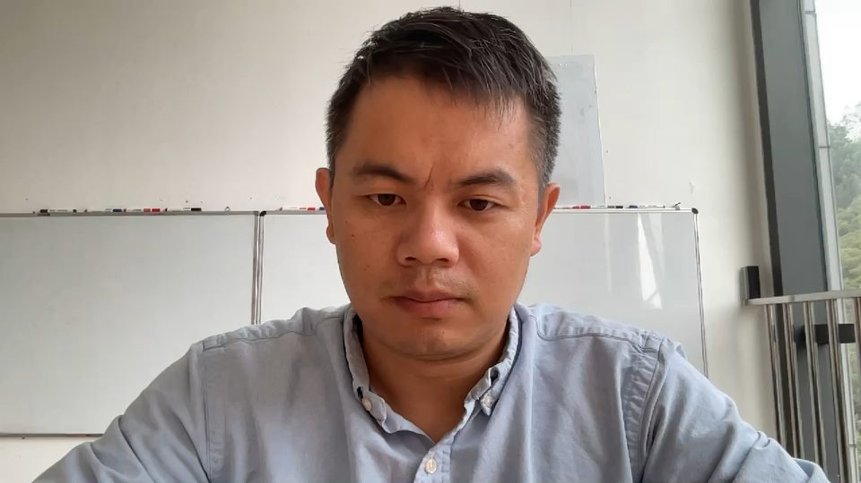
Teaching Pendant/Master Arm
Zhuorui YUN 999021264
Mechanical Engineering and Robotics
Guangdong Technion - Israel Institution of Technology
yun24239@gtiit.edu.cn
December, 2025

Slide 2
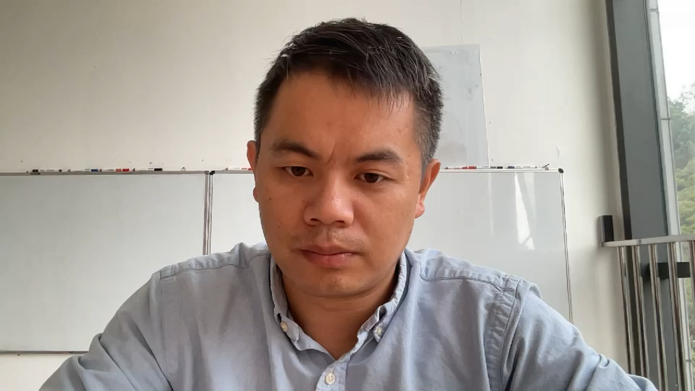
Background and motivation

Slide 3
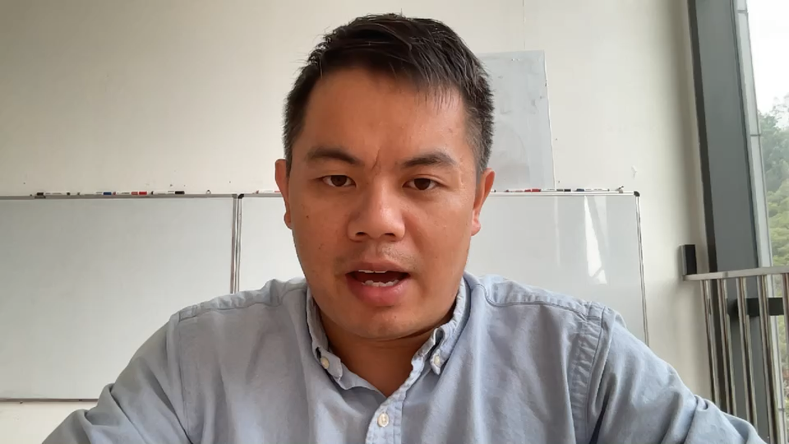
Goal and Demo

Slide 4
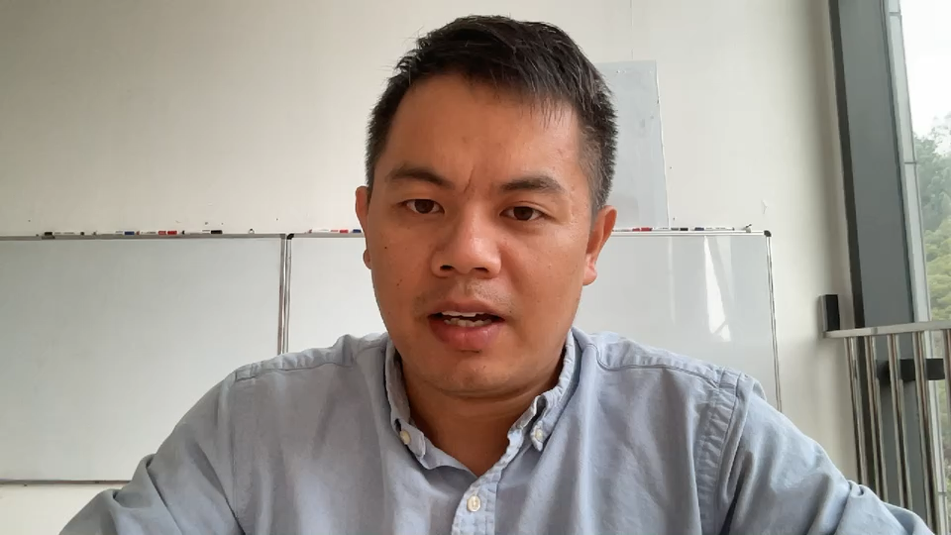
System overview

Slide 5
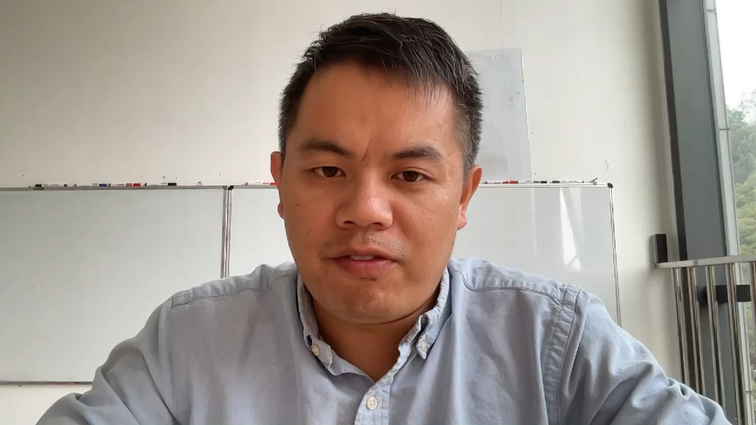
Working principle of ultrasonic sensor
Insert the key code here:

Slide 6
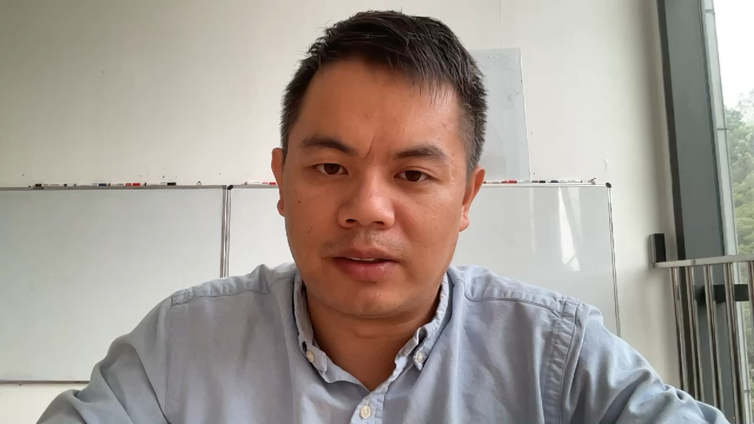
Working principle of ultrasonic sensor

Slide 7
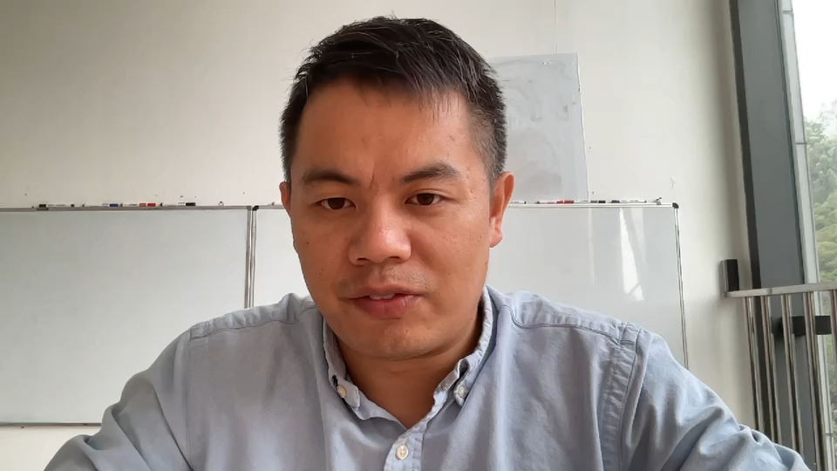
Problems I have found in this system

Slide 8
Something new did by me

Slide 9
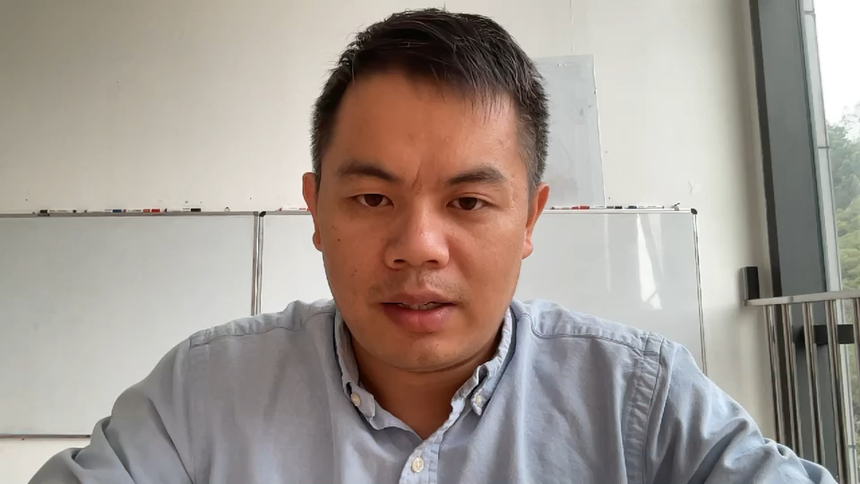
Summary

Slide 10
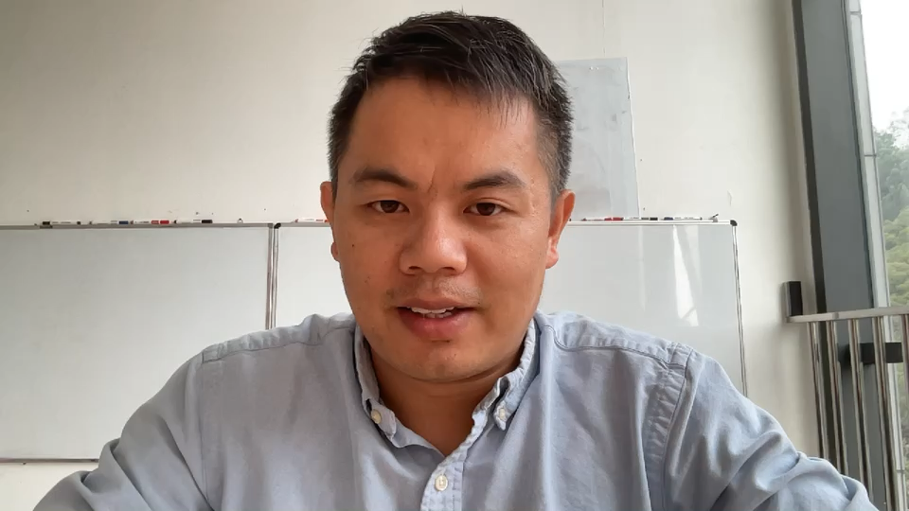
Future work
What is the important thing that has not been done in your project?
If you are given more money and time, what are you going to do differently here?

